Slide 1
Stats 131 - Kickstarter Data Analysis
Team 15 - HALLO
Members: Kai Chen Tan, Qi Jing Yap, Yuqing Yang, Steven Salmeron

Slide 2

Parts of a Kickstarter Project
Classification:
ID - internal unique number assigned to each project
main_category - classification of projects based on shared characteristics
Backing:
backers - number of individual contributors to a project
usd_pledged_real - total fundraised at end of project in USD, conversion done by fixer.io
usd_goal_real - project funding target in USD, conversion done by fixer.io
Status:
launched and deadline - date project began and ended
status - final outcome of project after deadline
Variables Created:
project_length - number of days between launched and deadline
pledged_per_backer - mean amount pledged (in USD) for each backer
percent_funded - percentage of goal that was pledged
‹#›
Notes:
Kickstarter is a fundraising platform that allows fans of a project to directly fund creators.

Slide 3
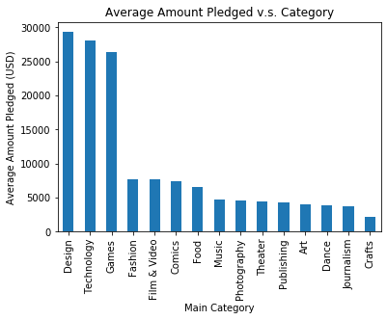
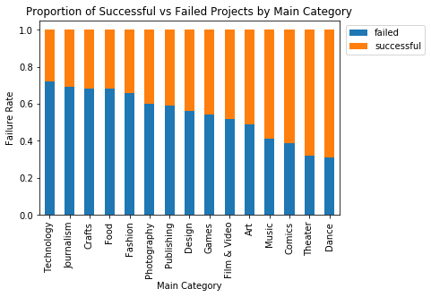
Guiding Question 1: Which category is the most well-funded?
Top 3 categories by success rate: Dance, Theater, Comics
Top 3 categories by average amount pledged: Design, Technology, Games
Projects that visitors to Kickstarter care about and fund the most
‹#›
‹#›
Notes:
while these main categories may not be the genres with the most number of projects started on the website or the highest success rates, these are the type of projects that visitors to Kickstarter care about the most, in terms of willingness to contribute as well as enthusiasm in funding the projects significantly.

Slide 4
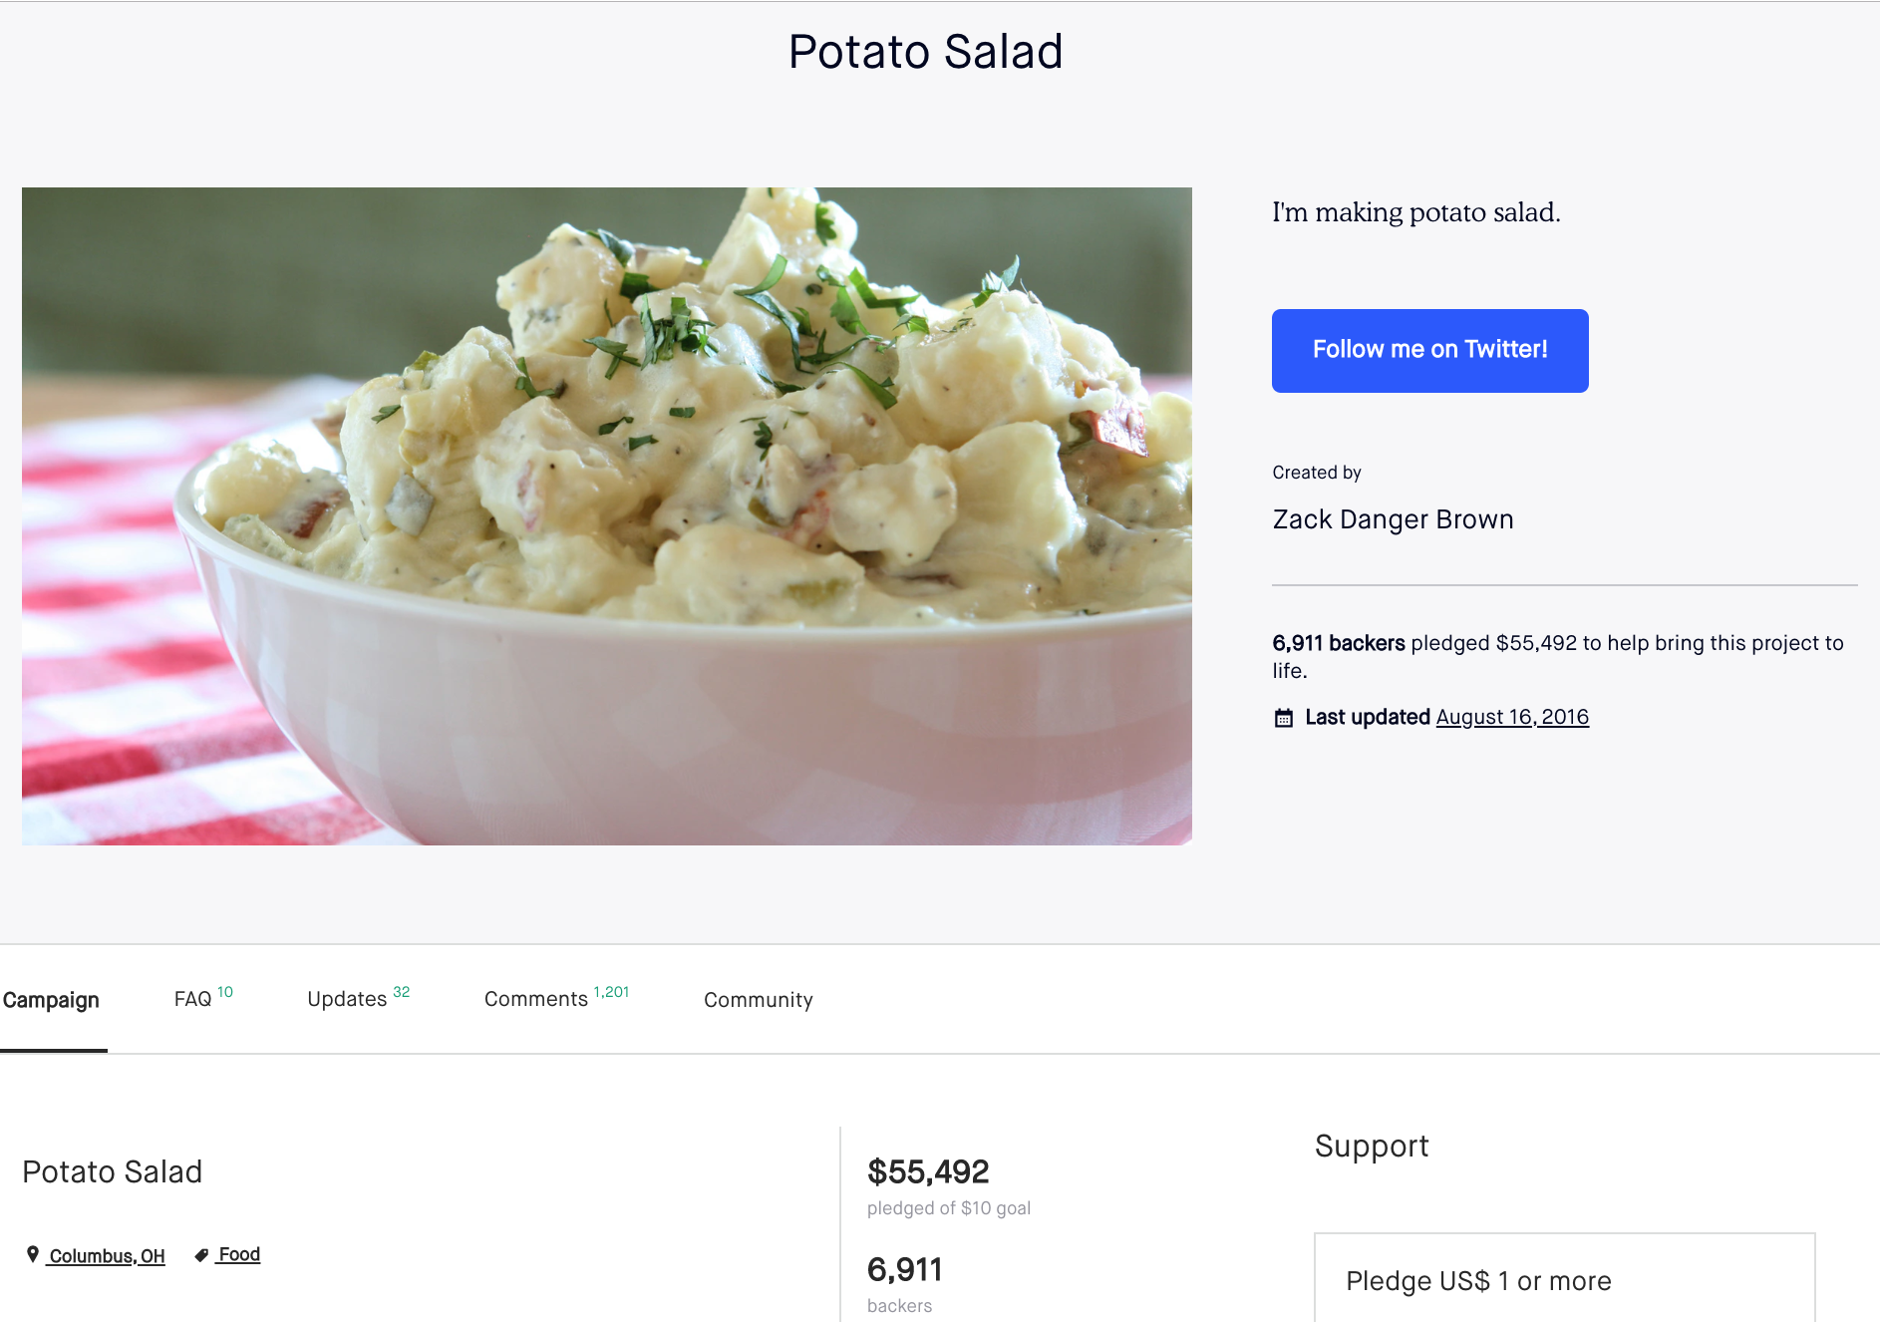
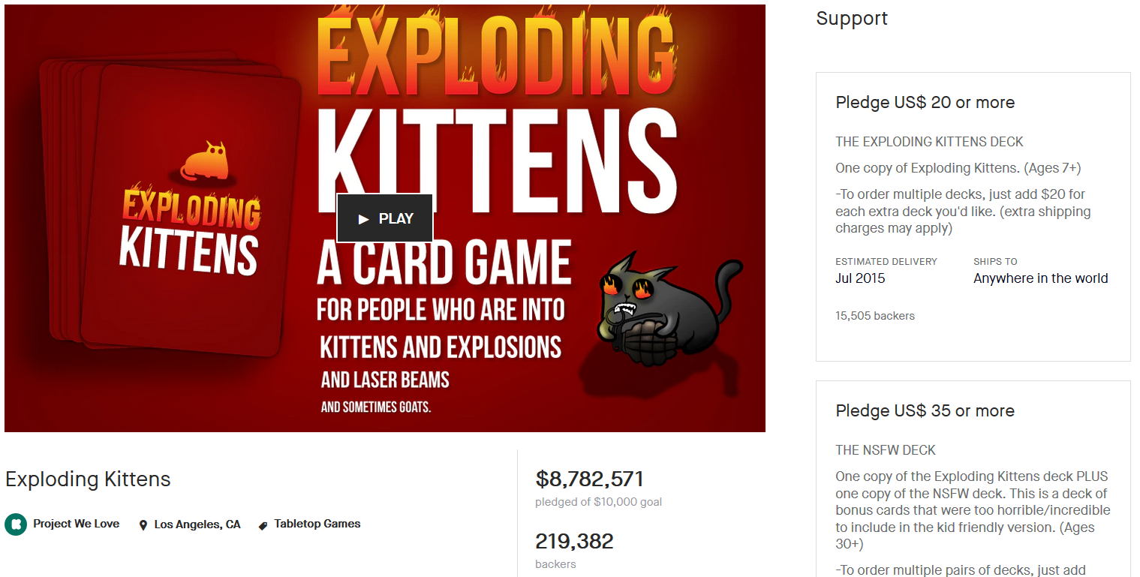
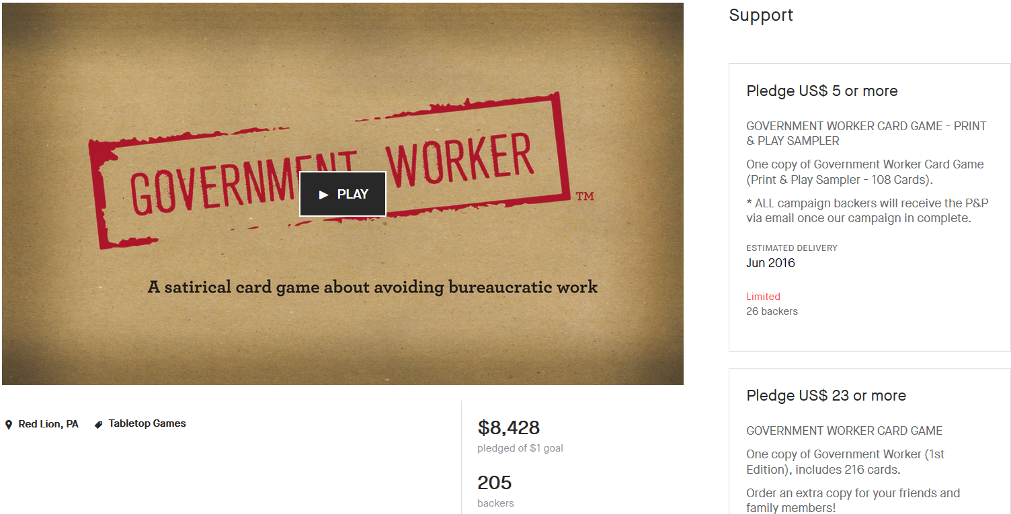
Guiding Question 2: Exploring Highly Successful Projects
We looked at projects that have fundraised amounts far exceeding their goal (percent_funded)
Project at the 99th percentile has fundraised 1323% of its goal
Factors: Crazy popularity, extremely low goal, or meme/joke projects
Highly successful projects with extremely low goals: mostly Music & Art
Highly successful projects with reasonable goals: mostly Games & Design
‹#›

Slide 5
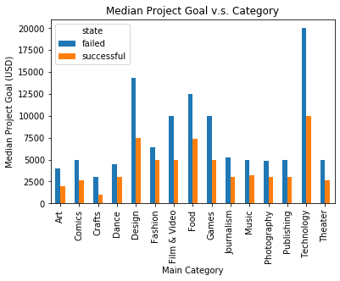
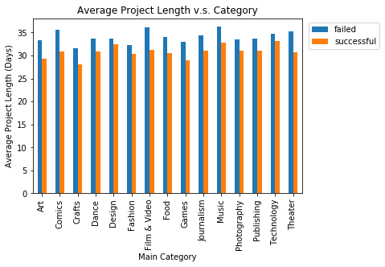
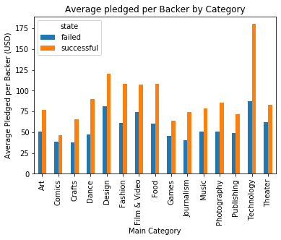
Guiding Question 3: What are some factors that may impact the outcome of a project?
Successful projects tend to have lower goals.
Failed projects tend to have longer project lengths.
Average pledged per backer is higher for successful projects.
‹#›

Slide 6
Modeling the Data: Selection and Prediction
K-Nearest Neighbors
Logistic Regression
01
Model Selection
- 70/30 split of the dataset into Train/Test
- Variables: Goal, Project Length, Average pledge per backer
- 70/30 split of the dataset into Train/Test
- Variables: Goal, Project Length, Average pledge per backer, Main Category
02
5-Fold Cross Validation
- Obtained K = 19 as best parameter
- Mean Validation Accuracy of ~74%
- Mean validation accuracy of ~69%
03
Applying Models on Test Data
- Test Accuracy of ~74%
- Similar Test Accuracies to Cross Validation
- Significant improvement from just predicting projects as failed (~54% accuracy)
- Test Accuracy of ~69%
- Similar Test Accuracies to Cross Validation
- Significant improvement from just predicting every project as failed (~54% accuracy)
Notes:
Difficult to interpret KNN model reasonably
Logistic model: all features significant except main_category: ‘Film & Video’
Coefficients reflect expectations based on insights from Guiding Questions

Slide 7
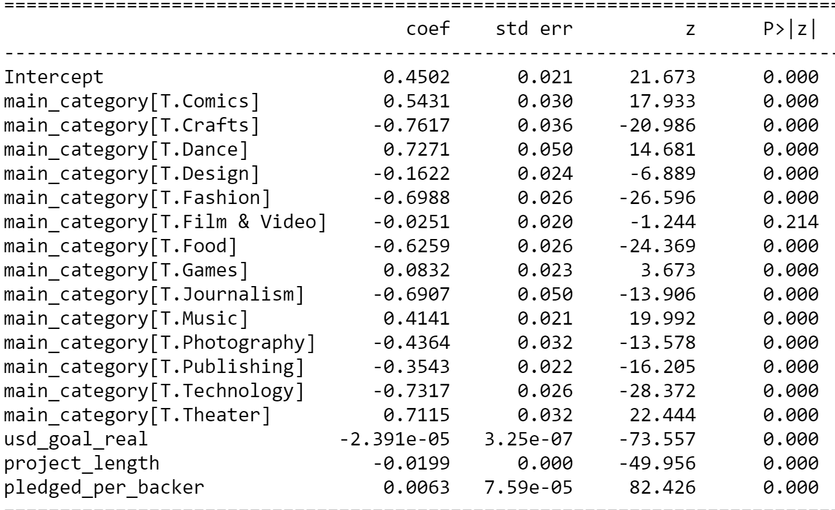
Modeling the Data: Interpretation
Difficult to interpret KNN model
Logistic Model - all features significant except main_category: ‘Film & Video’
Coefficients reflect expectations based on insights from graphs

Slide 8


